Slide 1
Cisco Unified Contact Center Express 10.5(1)
Daniel Nicholson
Collaboration Consulting Systems Engineer (Southeast Territory)

Slide 2
Agenda
What’s new with Unified CCX 10.5
User Experience Enhancements
Deployment Simplification
Extended Value with Workforce Optimization 10.5

Slide 3
Unified Contact Center Express 10.5(1) Feature Overview

Slide 4
Cisco Customer Collaboration Platforms
Flexible
Scalable
Cisco Unified Contact Center Enterprise
Hosted Collaboration Solution for Contact Center (HCS-CC)
Now providing solution for 20 to 12k seat end-customers
Full-Featured
Packaged
Packaged Contact Center Enterprise
All-in-One
Cisco Unified Contact Center Express
Notes:
Cisco Unified Contact Center Enterprise is our preeminent, premises-based product. It offers the most advanced functionality and the widest range of features in the product line. This is the solution for you if:
You have proficient in-house IT resources
You want an on-premise solution
You need top-of-the-line features or extensive scalability
Cisco Packaged Contact Center Enterprise gives you many of the critical enterprise capabilities of the Cisco Unified Contact Center Enterprise, but packaged into a smaller version. It is easier to set up and less expensive to deploy and maintain. This is the solution for you if:
You want enterprise capabilities but don’t need the full power of Cisco Unified Contact Center Enterprise
Cisco Unified Contact Center offers workforce optimization at an affordable price point. This is the solution for you if:
You’re just starting to explore the world of customer collaboration
Hosted Collaboration Solution for Contact Center gives you the same capabilities as the Cisco Unified Contact Center Enterprise in a hosted version. This is the solution for you if:
You want comprehensive customer collaboration features but need to focus IT resources on your core business
You prefer an operating expenditure investment model to a capital expenditure model

Slide 5
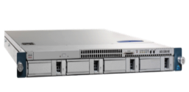
Cisco Unified Contact Center Express
Desktop Application
Finesse
Cisco Agent Desktop
Options
High Availability
Workforce Management
Outbound IVR
ASR/TTS
Quality Management
CRM Connectors
Contact Center Express
Voice
Chat, Email
API
IVR
Social Media
Reporting
Application Platform
SocialMiner
Unified Communications Manager
Business Edition 6000 and 7000, Spec-based HW
All in One Solution
Easy to Deploy
Easy to Use
Notes:
Focus: all in one, simplicity
Maintained that over the years, while adding a lot of value (email, chat, HA, outbound)
Now started to overhaul the product step by step. Continuity is key. New reporting, new desktop, new admin. More detail to come.

Slide 6
Unified Contact Center Express 10.5(1) User Experience Enhancements

Slide 7
Unified CCX 10.5 – What’s new
User Experience
Simplification
Extend the Value
Enhanced Web Chat
Predictive Outbound Agent
Finesse enhancements
Prime Collaboration Deployment
E164 enhancements
IPv6
Workforce Optimization enhancements

Slide 8
IVR Scheme CC
Call Presented in IVR CC
-Access IVR only
-Go to CC
Audix Success
Audix Hangup
Call Presented in Queue (15+2+2)
Abandoned
Customer Care

Slide 9
IVR Scheme EB
Call Presented in IVR EB
-Go to EB
Audix Success (NA)
Audix Hangup (NA)
Call Presented in Queue ( unlimited )
Abandoned
Employee Benef

Slide 10
Graphic Reporting Analysis

Slide 11
Answered versus Abandoned (Mon)

Slide 12
Answered versus Abandoned (Tue)

Slide 13
Answered versus Abandoned (Wed)

Slide 14
Answered versus Abandoned (Thu)

Slide 15
Answered versus Abandoned (Fri)

Slide 16
User Experience Enhancements
Predictive Outbound Agent
Predictive and Progressive outbound capability for proactive customer care.
Call Progress Analysis at Gateway for improved agent productivity
Enhanced Web Chat
Better customer care experience with additional channel
Multiple session capability allows better productivity
Cisco Finesse Enhancements
Multiline and Extension mobility for agent productivity
Localization supports global requirements
CRM connectors improves agent experience

Slide 17
Outbound Agents
Predictive and Progressive
Direct Preview, Predictive and Progressive dialer with Finesse
Up to 150 concurrent outbound sessions
Separate license required
CAD supports Preview only
Blended Inbound and outbound operations
Call Progress Analysis with ISR Gateway
Outbound reports
Campaign Management with API support
Notes:
SIP based CPA – means that the CPA will be done at the gateway level, requiring a specific gateway IOS level (Not sure if its supported in ASR and ISR…this was asked at the SEVT)
Blended mode support – for simultaneous inbound & outbound if needed (or go pure outbound too)
Campaign API’s are available now - 3rd party developers have created complex apps to work with these
Config API’s to manage outbound configs as well
-------
And just so I'm clear on all of it with UCCX 10.5 for Outbound:
- CAD - supports Preview only
- IP IVR - supports Progressive and Predictive
- Finesse - supports Direct Preview, Predictive and Progressive

Slide 18
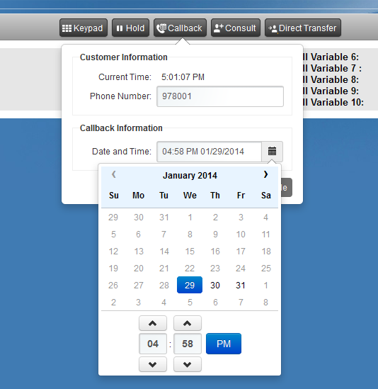
Outbound Agent
Scheduled Callback
Available
On an outbound call
In wrap-up after an outbound call
On hold on an outbound call
Option to edit the phone number

Slide 19
Direct Preview Outbound
Cisco Finesse Preview Outbound
All Outbound Modes – Agents are put in “Reserved (Outbound)” State
Direct Preview Mode - A reservation call lets the agent decide how to respond to the contact
Direct Preview Mode- When the agent accepts the contact, the outbound call is made

Slide 20
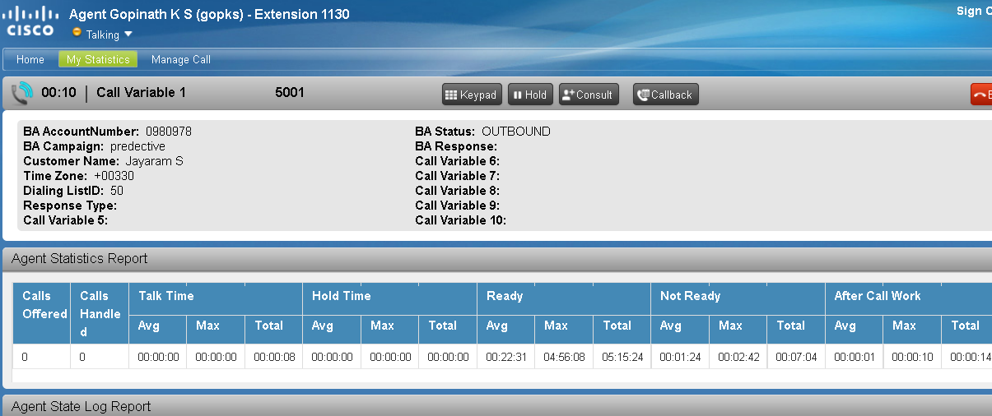
Predictive & Progressive Outbound Agent
Call Control
Agent Reserved for Outbound
Live Voice detected

Slide 21
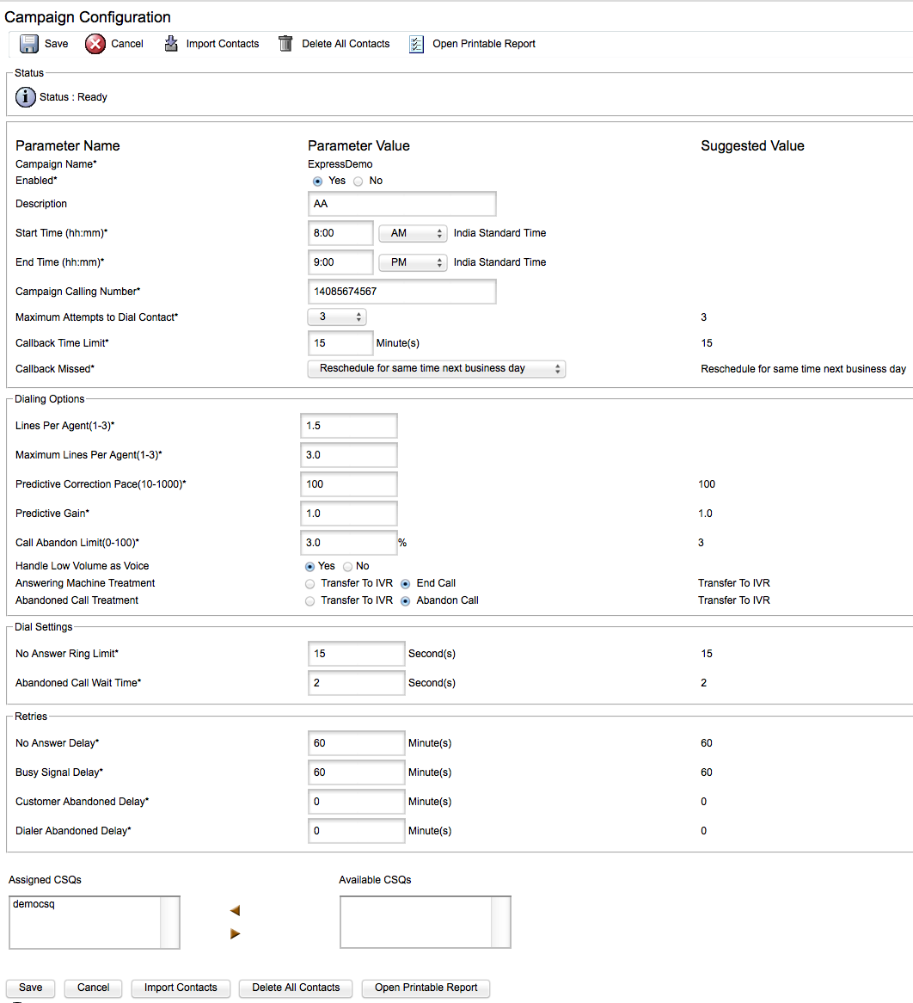
Campaign Management
Configurable timings
Attempts and Callback settings
Dialing Options
Lines per Agent
Predictive Correction Pace and Gain
Various treatments
Dial Settings
Retries
Assigned Contact Service Queues
Import Contacts
Notes:
The Campaign management interface provides a facility for the campaign administrator to modify many aspects of the outbound campaign. There are many and sometimes very strict regulations governing what are sometimes termed nuisance calls, or abandoned calls, and this facility allows administrators to keep their campaign performance within the prescribed guidelines. Key Parameters such as lines per agent, call abandon limit, maximum attempts to dial, and a number of parameters related to retries all help to have a successful campaign that meets regulatory and customer centric requirements.

Slide 22
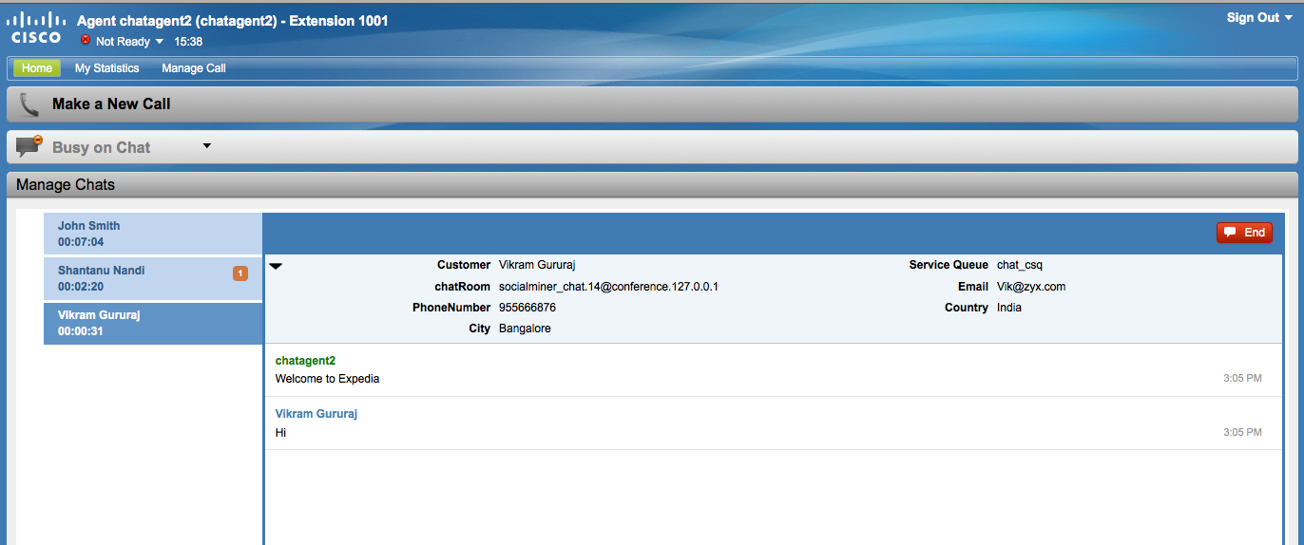
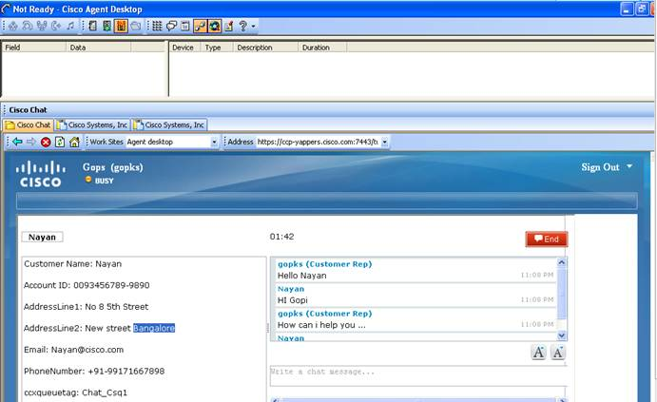
Web Chat Enhancements
Web Chat
SocialMiner
CCX 9.0
Single Session Web Chat
Basic functionalities
CCX 10.5
Multi-Session
Finesse Gadgets
Live Data
Historical reports
Notes:
CCX 10.5 introduces multi-session webchat, to cater for those contact centers making heavy use of webchat. The agent experience is greatly simplified by having this functionality smoothly integrated in the Finesse desktop, and the associated live and historical reports available for chats ensures that Contact center performance and individual agents can be credited with their agent webchat activity.

Slide 23
Web Chat Enhancements
Multi-Session ( upto 5) with Finesse
60/120 concurrent sessions
Predefined Responses
Audible Alert
Agent Alias
Transcript Download
Live Data and Historical Reporting
Blended (Configurable) Voice/Chat Agent Operations
Available with Premium Agent Licensing

Slide 24
Live Data
Outbound and Web Chat Reports

Slide 25
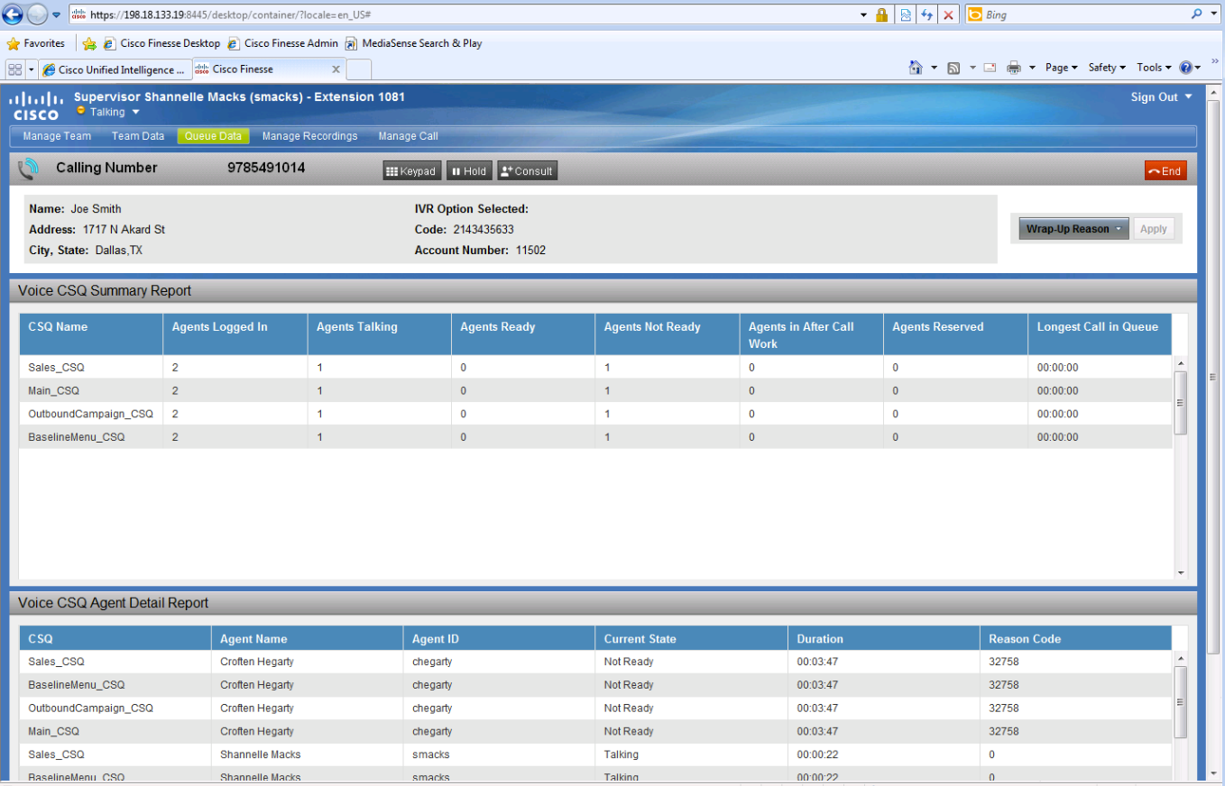
Finesse Enhancements
Direct Preview, Progressive and Predictive Outbound agent
Multi-session Web Chat
Multiline
Extension Mobility
QM Gadget
Localization
Gadget Container enhancements
Jabber VXME support
CAD-BE dropped starting Unified CCX 10.5

Slide 26
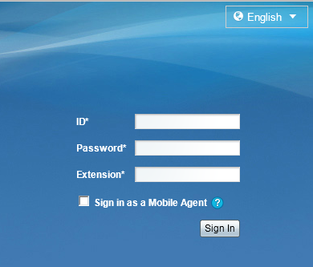
Finesse Localization
Agents choose their preferred language at login time
Agents can choose a different language each time they log in
Finesse for CCX 10.5 Supported Languages
Chinese – simplified | Finnish | Polish
Chinese - traditional | French | Portuguese
Danish | Italian | Russian
Dutch | Japanese | Spanish
English | Korean | Swedish
German | Norwegian | Turkish

Slide 27
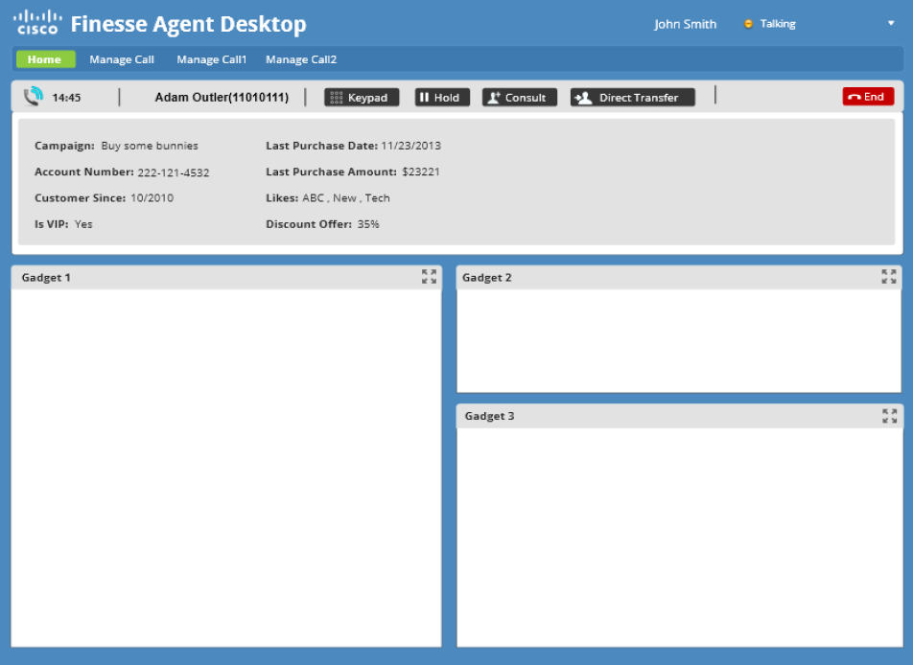
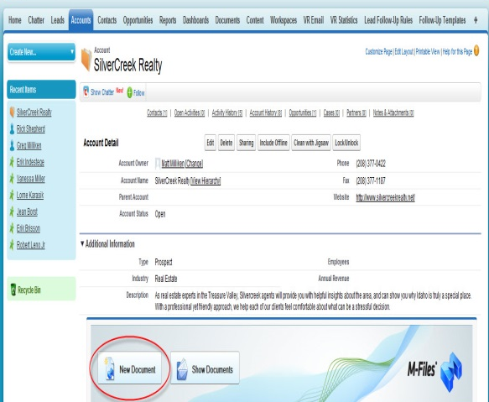
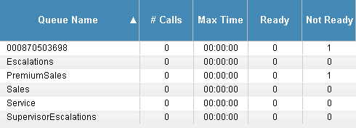
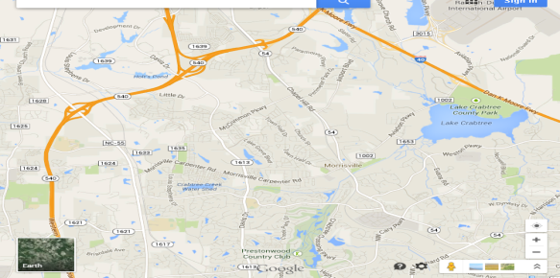
Finesse Gadget Container Enhancements
Multiple Columns of Gadgets
Side-by-Side Gadgets
Each Finesse tab can have a different number of columns

Slide 28
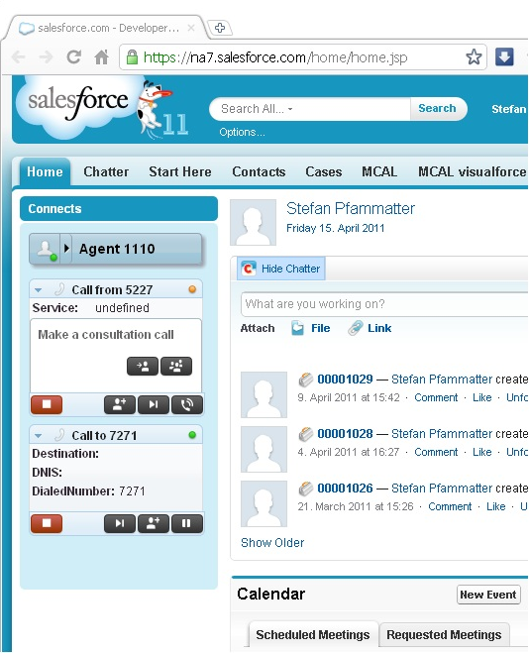
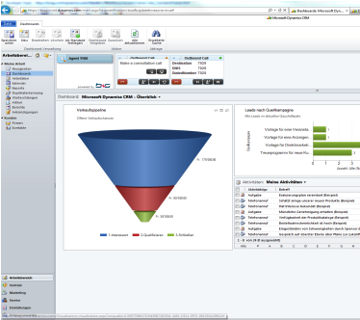
Finesse & CRM Connectors
Connectors from Bucher+Suter
Salesforce.com
Microsoft Dynamics

Slide 29
Unified Contact Center Express 10.5(1) Deployment Simplification

Slide 30
Simplification
Cisco Prime Collaboration Deployment
IP address and Host name change allows ease of deployment
E164 Support
Complete international dial plan support

Slide 31
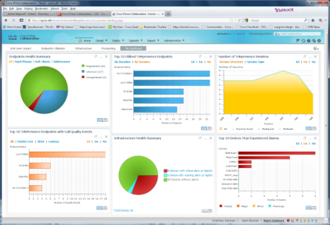
Cisco Prime Collaboration Deployment and Assurance
Assurance: Features
Deployment:Features
System Health Monitoring/Trending [CPU, Memory, Disk]
Voice Services Monitoring [Up/Down status]
Reachability Monitoring
Syslog based alerting (customizable)
Benefits
Upgrade from CCX 9.0(2)
Fresh Install for CCX 10.x
IP address change
Hostname Change
The solution helps optimize use of critical collaboration infrastructure and resources.
Rapid isolation of problems and accelerated troubleshooting reduce mean time to repair (MTTR).

Slide 32
Unified CCX : E.164 with Finesse
CCX 10.0
CCX 10.5
Agent Desktop
Agent extension
Display of Incoming call
Phonebook and Keypad
Configuration
Route point ( Trigger)
Configuration API for Route Point
Reporting
DB schema, Intelligence Center
Script Editor
Call control steps
Call Control Group (CTI Port)
Outbound Contact List

Slide 33
Unified Contact Center Express 10.5(1) Extended Value - Workforce Optimization 10.5

Slide 34
Extend the Value
IPv6
Support for Dual Stack IPv6 helps customer to use the Unified CCX in next generation networks.
Workforce Optimization
Improved supervisor experience with schedule on mobile and recording controls in Finesse gadget
Better Workforce efficiency with multi-channel forecasting capability
Easier manageability with eliminated Java dependency.

Slide 35
IPv6 Support
UCCX
Dual stack support
Finesse deployments
High Availability
Caveats:
IPv4 for
ASR/TTS
MediaSense
WFO
TCP
UDP
IPv4
IPv6
Data Link (Ethernet)
Dual stack in a device means that both IPv4 and IPv6 stacks are enabled: Applications can talk to both at the same time.
Notes:
ASR/TTS from Nuance will not support Ipv6, nor does MS nor Calabrio WFO

Slide 36
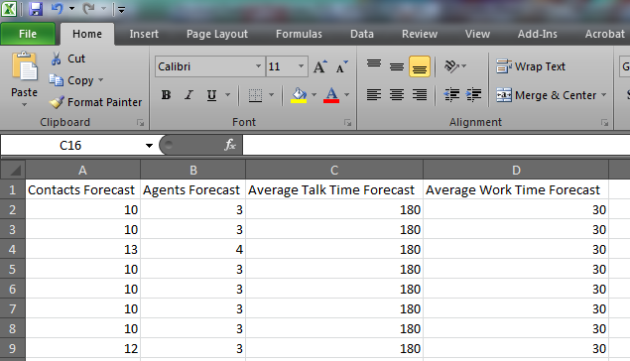
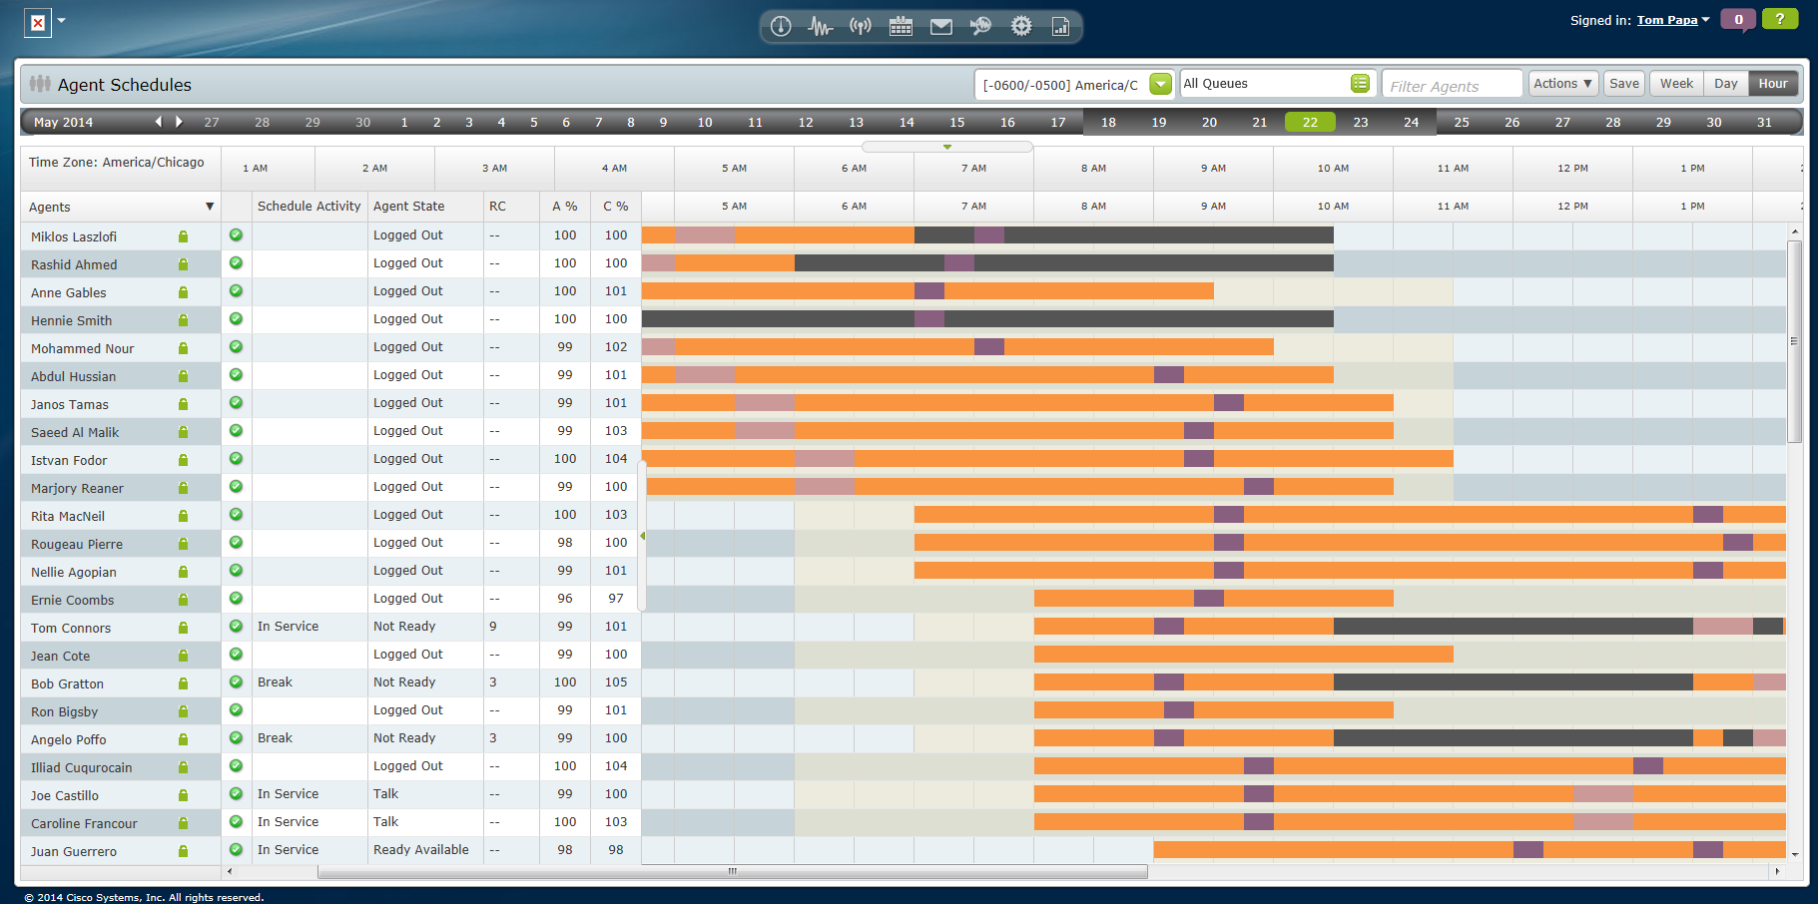
Workforce Management 10.5
Workforce Management
Multi-Channel Forecasting
Agent Schedules on Mobile
Copy/Paste Support for Forecast Edit & Distribution
Abandoned Calls Metric in Agent Schedules
User Interface Refresh

Slide 37
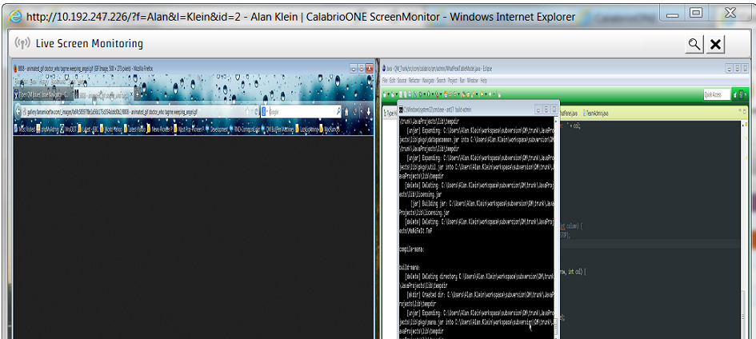
Quality Management 10.5
Quality Management
Finesse Gadgets for recording controls
Live Screen and voice monitoring
Eliminate Java Dependency
Whisper/Barge-In Feature
Points based Evaluations
Hyperlink access to recordings

